Slide 1
The Share of the Total View
or: why you should vote

Slide 2
SHARE OF THE TOTAL VIEW
In a collective act, each person produces her share of the total benefit.

Slide 3

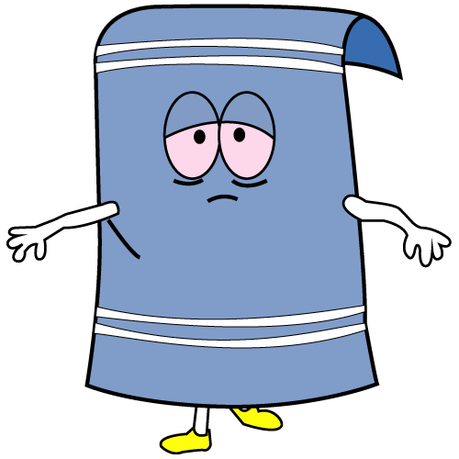



4 Rescuers Required
1 Rescuer Required
THE FIRST RESCUE MISSION
100 Miners
1 Miner

Slide 4
4 Rescuers Required
1 Rescuer Required
= 20 lives saved
= 20 lives saved
= 20 lives saved
= 20 lives saved
= 20 lives saved
SHARE OF THE TOTAL
Butters stays
100 Miners
1 Miner

Slide 5
4 Rescuers Required
1 Rescuer Required
= 20 lives saved
= 20 lives saved
= 20 lives saved
= 20 lives saved
= 20 lives saved
100 Miners
SHARE OF THE TOTAL
Butters stays
1 Miner

Slide 6
4 Rescuers Required
1 Rescuer Required
= 25 lives saved
= 25 lives saved
= 25 lives saved
= 25 lives saved
= 1 life saved
SHARE OF THE TOTAL
Butters goes
100 Miners
1 Miner

Slide 7
4 Rescuers Required
1 Rescuer Required
= 25 lives saved
= 25 lives saved
= 25 lives saved
= 25 lives saved
= 1 life saved
100 Miners
SHARE OF THE TOTAL
Butters goes
1 Miner

Slide 8
REVISED SHARE OF THE TOTAL
When a person joins others in doing good, the good that she does is not just her share of the total benefit produced.
She must subtract from her share any reduction that her joining causes in the shares of the benefits produced by others.

Slide 9
4 Rescuers Required
1 Rescuer Required
=25 - 5 = 20 lives saved
=25 - 5 = 20 lives saved
=25 – 5 = 20 lives saved
=25 – 5 = 20 lives saved
= 20 + (-5 * 4) = 0 lives saved
REVISED SHARE OF THE TOTAL
Butters stays
100 Miners
1 Miner

Slide 10
4 Rescuers Required
1 Rescuer Required
=25 - 5 = 20 lives saved
=25 - 5 = 20 lives saved
=25 – 5 = 20 lives saved
=25 – 5 = 20 lives saved
= 20 + (-5 * 4) = 0 lives saved
100 Miners
REVISED SHARE OF THE TOTAL
Butters stays
1 Miner

Slide 11
4 Rescuers Required
1 Rescuer Required
=25 lives saved
=25 lives saved
=25 lives saved
=25 lives saved
= 1 life saved
REVISED SHARE OF THE TOTAL
Butters goes
100 Miners
1 Miner

Slide 12
4 Rescuers Required
1 Rescuer Required
=25 lives saved
=25 lives saved
=25 lives saved
=25 lives saved
= 1 life saved
100 Miners
REVISED SHARE OF THE TOTAL
Butters goes
1 Miner

Slide 13
4 Rescuers Required
1 Rescuer Required
THE SECOND RESCUE MISSION
100 Miners
50 Miners

Slide 14
4 Rescuers Required
1 Rescuer Required
100 Miners
THE SECOND RESCUE MISSION
50 Miners

Slide 15
4 Rescuers Required
1 Rescuer Required
= 25 lives saved
= 25 lives saved
= 25 lives saved
= 25 lives saved
SECOND RESCUE MISSION
Butters stays
100 Miners
50 Miners

Slide 16
4 Rescuers Required
1 Rescuer Required
= 25 lives saved
= 25 lives saved
= 25 lives saved
= 25 lives saved
100 Miners
SECOND RESCUE MISSION
Butters stays
50 Miners

Slide 17
4 Rescuers Required
1 Rescuer Required
= 0 lives saved
= 0 lives saved
= 0 lives saved
= 50 lives saved
SECOND RESCUE MISSION
Butters goes
100 Miners
50 Miners

Slide 18
4 Rescuers Required
1 Rescuer Required
= 0 lives saved
= 0 lives saved
= 0 lives saved
= 50 lives saved
100 Miners
SECOND RESCUE MISSION
Butters goes
50 Miners

Slide 19
FULL RESPONSIBILITY VIEW
A person must add any increase that she causes to the shares produced by others to her share of the benefit produced.

Slide 20
4 Rescuers Required
1 Rescuer Required
= 0 lives saved
= 0 lives saved
= 0 lives saved
= 50 lives saved
FULL RESPONSIBILITY
Butters goes
100 Miners
50 Miners

Slide 21
4 Rescuers Required
1 Rescuer Required
= 0 lives saved
= 0 lives saved
= 0 lives saved
= 50 lives saved
100 Miners
FULL RESPONSIBILITY
Butters goes
50 Miners

Slide 22
4 Rescuers Required
1 Rescuer Required
= 25 lives saved
= 25 lives saved
= 25 lives saved
= 25 + (3*25) = 100 lives saved
100 Miners
FULL RESPONSIBILITY
Butters stays
50 Miners

Slide 23
4 Rescuers Required
1 Rescuer Required
= 25 lives saved
= 25 lives saved
= 25 lives saved
= 25 + (3*25) = 100 lives saved
FULL RESPONSIBILITY
Butters stays
100 Miners
50 Miners

Slide 24
Problem
Why not take the relevant outcomes as including the opportunity cost?

Slide 25
Lesson
Your decisions about whether to work with others to do something should be based on the belief that you are entirely responsible for what the group does or doesn’t do.

Slide 26
SMALL CHANCES MATTER

Slide 27
Expected value
Expected value of an outcome:
The value of the outcome multiplied by the probability it will happen.
p(V)=EV
You should use the expected value in making decisions, not the value.
A 50% chance of $100 should be treated as $50.

Slide 28
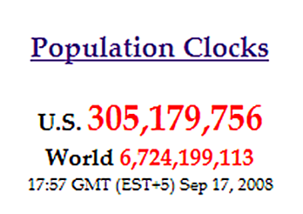
Expected benefit = (S*N/P)-C
S= Average net benefit to Americans of Superior candidate’s election.
N = Number of Americans.
P = Chance that your vote makes the difference.
C = Costs to you and others of you voting.
S = $100
N = 300 million
P = 1 in 100 million
C = -$100

Slide 29
S= Average net benefit to Americans of your candidate’s election.
N = Number of Americans.
P = Chance that your vote makes the difference.
C = Costs to you and others of you voting.

Slide 30
EXPECTED BENEFIT
Expected benefit = (S*N/P)-C
Expected benefit of you voting = $200

